Slide 1
Springboard Capstone 1
~~~Data Science Career Track~~~
Biomechanical Features of Orthopedic Patients
CLASSIFICATION
of
Spondylolisthesis

Slide 2
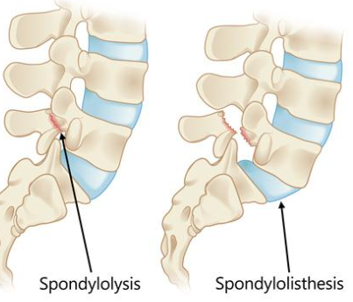
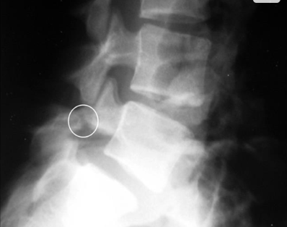
Painful lumbar (back) issues are primarily diagnosed on x-ray results
The problem is - Not all issues are as obvious as seen below
Reproduced from Cavalier R, Herman MJ, Cheung EV, Pizzutillo, PD: Spondylolysis and spondylolisthesis in children and adolescents: I. diagnosis, natural history, and nonsurgical management J Am Acad Orthop Surg 2006; 14: 417-424

Slide 3
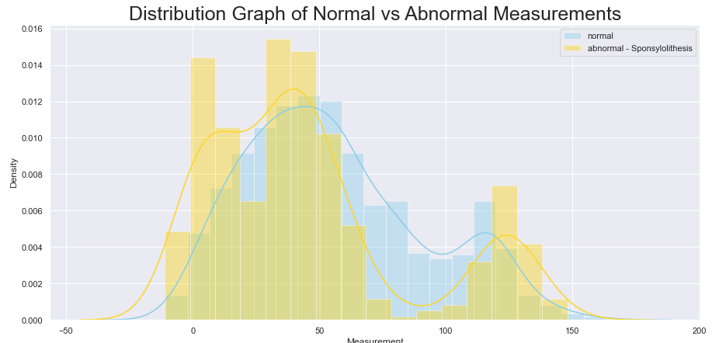
Abnormal measurements overlap Normal measurements.
It appears the high-bills you've paid for radiology results may have been well earned.

Slide 4
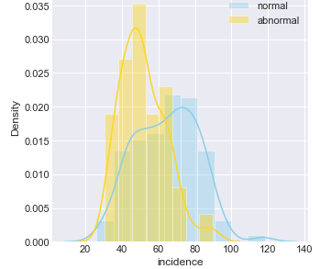
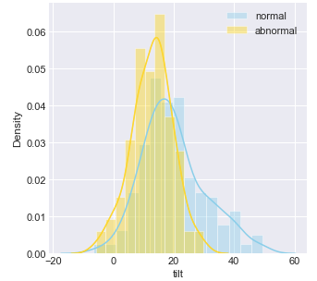
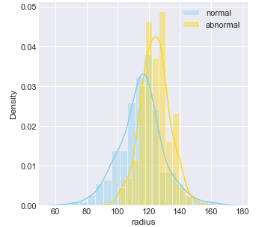
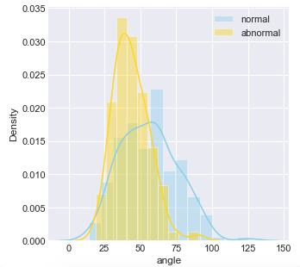
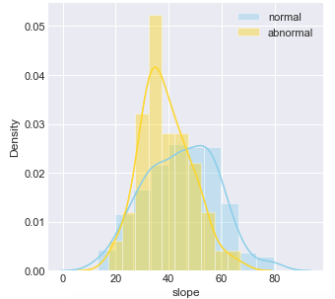
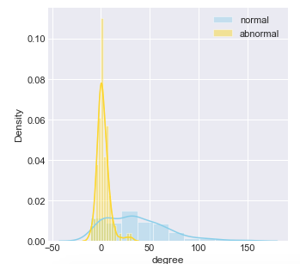
Proper diagnosis requires comparison of several features - simultaneously

Slide 5
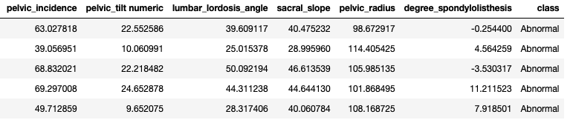
The physician bears the stress to simultaneously compare multiple measurements.
Machines are perfectly suited to assist.

Slide 6
Project: Classification of Spondylolisthesis
Problem:
Diagnosis requires simultaneous comparison of multiple features.
Solution:
Machine learning quickly classifies and sorts saving time and improving accuracy.

Slide 7
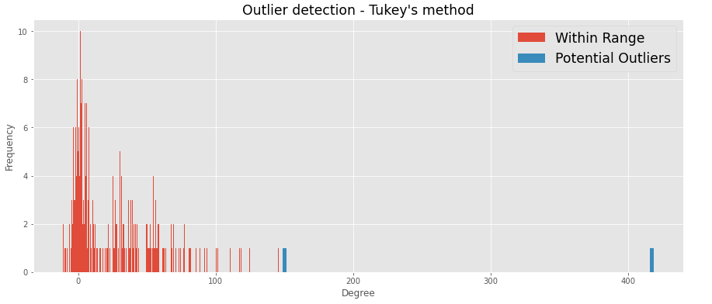
The Data
'Tukey's' algorithm was used to locate potential outliers.
1 outlier (410) was >2 times as large as the next data point (150) - it was removed.

Slide 8
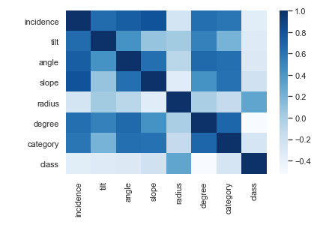
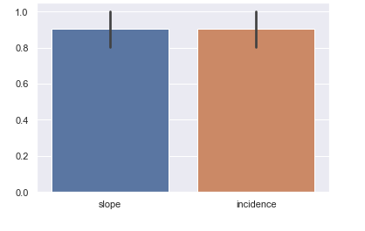
Correlations plotted to look for overly-correlated features
'slope' and 'incidence' were highly correlated, close to the 90% cut-off range.

Slide 9
A correlation module ran to remove overly-correlated features (>90%). All passed, none removed.

Slide 10
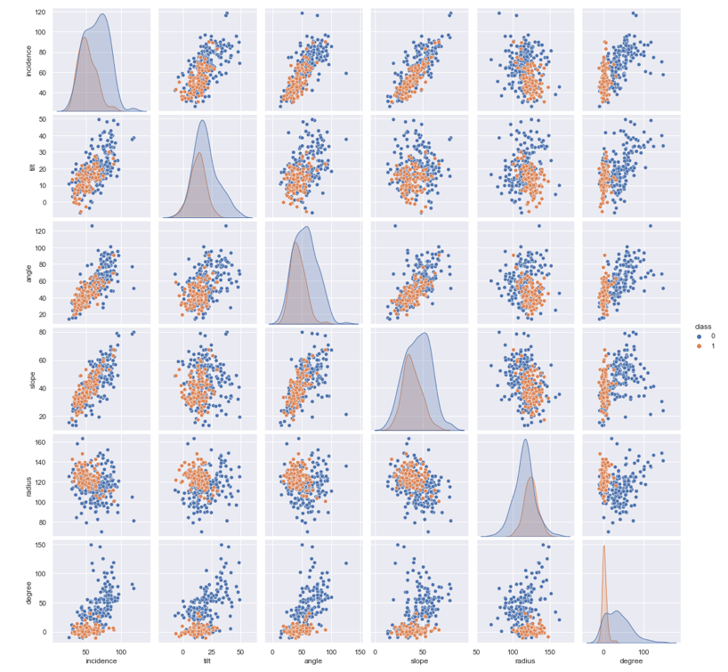
Correlations of features
Comparing the separation between "Normal" (orange) and "Abnormal" (blue)......
suggests that added weight might be useful on 'degree' and 'radius' to improve the model.

Slide 11
The Models
4 Models were used
Logistic Regression
Guassian Naive Bayes
KNearest Neighbors
Random Forest

Slide 12
Logistic Regression & The Base
A basic Logistic Regression was used to determine the base accuracy of 0.87
Additional tuning of C parameter using GridSearch did not change the results

Slide 13
Gaussian Naive Bayes
Due to the bi-model and right-skewed normal shape of some features - a Gaussian NB was tested with results less than the base

Slide 14
KN Neighbors
KN Neighbors returned the same accuracy after tuning the n_neighbors to =10
Tuning of parameters: algorithm, leaf_size, metric, metric_params did not improve accuracy.

Slide 15
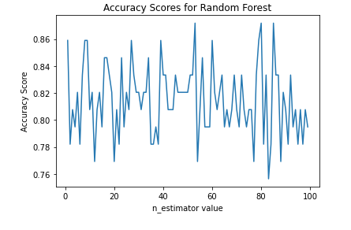
Random Forest
Random Forest provided improved results of 88% once the n_estimator and random_state were tuned in tandom.
A module was created to loop through a range of values, by plotting the results we see the optimal values.

